Slide 1

Group Discussion

Slide 2
Group Discussion
It refers to the situation where a particular number of people (three to eight) meet face to face and through free verbal interaction, originate, share and discuss ideas to arrive at a decision or solution to a problem.
Group discussions are used for decision-making and problem solving.
Group discussions are also used widely as a personality test for evaluating several candidates simultaneously.

Slide 3
Structure and Objective
A group of candidates is given a topic or case for discussion.
Normally groups of eight to ten candidates formed into a leaderless group, and are given a specific situation to analyze and discuss within a given time limit.

Slide 4
Structure
The group sits in circle or U-shape
They may either be given their choice of seat or seat allotted.
This panel observes and evaluates

Slide 5
Categories of Group Discussion
Organizational group discussions
Group discussions as a part of a selection process.

Slide 6
Brain Storming Technique
Brainstorming is a situation where a group of people meet to generate new ideas and solutions around a specific domain of interest by removing inhibitions. People are able to think more freely and they suggest as many spontaneous new ideas as possible. All the ideas are noted down without criticism and after the brainstorming session the ideas are evaluated.

Slide 7
Steps of Brain Storming Technique
Define the problem. The first step should be to determine a problem question that the brainstorming session will address. ...
Lay out the context and definitions. ...
Pick an appropriate facilitator. ...
Invite the right people. ...
Set the agenda. ...
Holding the session.

Slide 8
Nominal Group Technique
Nominal group technique (NGT) is defined as a structured method for group brain storming that encourages contributions from everyone and facilitates quick agreement on the relative importance of issues, problems, or solutions. Team members begin by writing down their ideas, then selecting which idea they feel is best. Once team members are ready, everyone presents their favourite idea, and the suggestions are then discussed and prioritized by the entire group using a point system. NGT combines the importance ratings of individual group members into the final weighted priorities of the group.

Slide 9
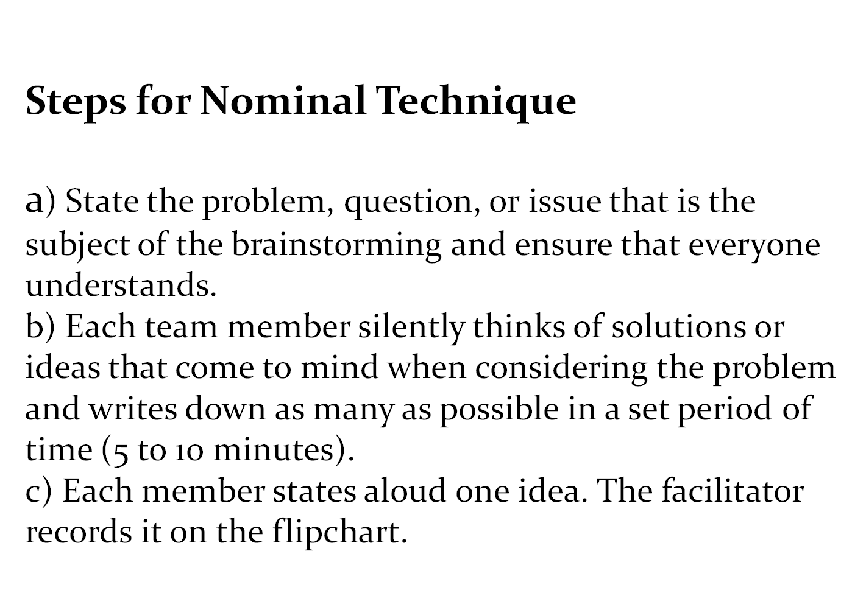

Slide 10
Limitations of Nominal Group technique
Restricts discussion or interpersonal communication during the decision-making process .
Though group members are all physically present as in a tradition committee meeting, they operate independently .

Slide 11
The Delphi Technique
The Delphi method is a framework process based on the results of multiple rounds of questionnaires sent to a panel of experts. Several rounds of questionnaires are sent out to the group of experts, and the anonymous responses are aggregated and shared with the group after each round. The experts are allowed to adjust their answers in subsequent rounds, based on how they interpret the "group response" that has been provided to them. Since multiple rounds of questions are asked and the panel is told what the group thinks as a whole, the Delphi method seeks to reach the correct response through consensus.

Slide 12
Steps of Delphi Technique
a)The problem is identified and members are asked to provide potential solutions through a series of carefully designed questionnaires.
b) Each member anonymously and independently completes the first questionnaire.
c)The results of the first questionnaire are compiled at a central location, transcribed and reproduced.
d) Each member receives a copy of the results.
e) Based on the result ,another questionnaire is prepared, and the members are again asked for the solutions

Slide 13
GD as a Part of Selection Process
During a GD employers evaluate potential for leadership and ability to work in a team.
The four components generally evaluated in a group discussion are:
  Knowledge
  Communication skills
  Group behaviour
  Leadership potential

Slide 14
Communication Skills
Candidate assessed in terms of:
Active listening
Clarity of thought and expression
Apt language
Appropriateness of body language
Lucidity

Slide 15
Tone: Quality or character of the voice expression a particular feeling or mood
Voice: Power of speech
Articulation: Act of speaking or expressing an idea in words
Fluency: Speaking or writing in an easy, flowing style
Modulation: Variations in rate, tone, or volume of voice
Good delivery: The ideas expressed fluently in the right voice, right tone, and right articulation.
It isn’t sufficient to have ideas. They have to be expressed effectively.

Slide 16
Apt Language
Fluency and accuracy in use of language free from grammatical errors.
Directly, clearly and precisely put ideas in a organized fashion.
Simplicity and unambigusity
Using too much of jargon or high-sounding words or ambiguous expressions may project as a show-off and may not endear to group members.

Slide 17
Effective Use of Body Language
Looking attentively at the speaker and nodding
While speaking, ensuring no one is ignored. Looking at everybody.
Avoiding overt gestures
Avoiding pointing out fingers
Avoiding monotonous posture by shifting slightly in the chair or placing arm on the back of your chair
Not showing interest or dislike in the topic.
Even if one does not like the topic he should try to develop interest and reveal interest and enthusiasm through appropriate facial expression.

Slide 18
Group Behaviour ( Team Spirit)
group behaviour is reflected in ability to interact with other members of the group on brief acquaintance.
Emotional maturity and balance promotes good interpersonal relationships. One is expected to be more people centric and less ego centric.
Remaining objective, empathetic, and non-threatening, and behaving maturely as a good team player

Slide 19
Essence
Consistent participation
Keenness in listening and observing
Time sharing and orderly conduct
Ability to handle turbulent situations
Ability to cut excessively exuberant participants down to size
Ability to dominate the proceedings without bullying others
Avoiding personal comments

Slide 20
Leadership Skills
The success of any team depends to a large extent, on its leader.
The candidate who possesses both functional ability and coordinating ability would emerge as the leader.
Functional ability involves knowledge, mental and physical energy, emotional stability, objectivity, communication skill, integrity and emotional intelligence

Slide 21
Do’s
Sitting comfortably
Listening to topic
Organizing ideas
Speaking at the earliest
Identifying supporters/ opponents
Keeping track of time
Sharing time fairly
Maintaining eye contact
Taking notes
Aiming for summary if needed

Slide 22
Don’ts
Moving excessively
Throwing all ideas at one shot
Speaking fast
Digressing
Indulging in ill conversation
Paying attention to bull dozers
Using slang
Getting emotional
Being in a hurry
Being silent
Dominating vocally/physically
Assuming role of chairman
Taking extreme stance
Maintaining eye contact with the facilitator

Slide 23


